Slide 1
Course Title:
Mathematical Optimization
(2-2-0-0)
Topic :
Formulation of Linear Programming Problem
CO-1
Session -03

Slide 2



AIM
To familiarize students with the concept of formulation of linear programming problem
INSTRUCTIONAL OBJECTIVES
This session is designed to:
Describe develop and understanding of linear programming problem.
Demonstrate how to formulate linear programming problem
Illustrate in detail of objective function.
LEARNING OUTCOMES
At the end of this unit, you should be able to:.
Describe the ways to construct the mathematical formulation of linear programming problem
Solve the formulation of linear programming problem.

Slide 3
Mathematical OPTIMIZATION- Co’s
CO1: Linear Programming: Formulation of LP Problem (LPP), Graphical method, Simplex method, Transportation problem, Duality concept in LPP, Feasibility of solution using Farka’s Lemma, Ellipsoid method, Karmarkar’s Algorithm .
CO2: Combinatorial Optimization , Integer Programming, Branch & bound algorithms, valid inequalities & cuts. Fractional Programming. Combinatorial Optimization: Approximation Algorithms, Submodular functions, Matroids, Continuous approximation algorithms. Dynamic programming: Knapsack problem, Travelling salesman problem
CO3: Non-Linear Programming : Quadratic programs – Constrained quadratic programming problems, Beale’s method, Wolfe method, Karush-Kuhn Tucker (KKT) Conditions. Geometric Programming: Problems with one-degree of difficulty with positive coefficients, Geometric programming with constraints, Problems with positive and negative coefficients
CO4: Infinite Dimensional Optimization : Heuristic and Meta heuristics, Single solution vs. population-based, Parallel meta heuristics, Evolutionary algorithms, Nature-inspired metaheuristics, Genetic Algorithm, Ant-colony optimization, Particle swarm optimization, Simulated annealing

Slide 4
Mathematical OPTIMIZATION course Objectives
CO1 (Linear Programming)
  Formulation of linear programming
  Finding optimal solution to LPP by
    Graphical Method
    Simplex Method
  Duality Principle
  Transportation problem formulation and minimum cost computations
CO2 (Integer Programming)
  Formulation of integer programming problems(IPP)
  Finding optimal solution to IPP
    Branch and Bound
    Gomory’s cut method
  Matroids
  Approximation algorithms
CO3 (Non-Linear Optimization Problems)
  Introduction to convex sets, convex function and convex optimization
  Semi-definite programming, conic programming, second order conic programming
  Quadratic programming
    KKT conditions
    Beale’s method
    Wolf method
  Geometric programming
CO4 (optimization based search algorithms)
  Finding the global optimal solution
    Hill climbing methods
    Heuristics and meta heuristics
    Simulated annealing
    Ant colony optimization
    Evolutionary Genetic algorithms
    Particle Swarm Optimization

Slide 5
Objective
To develop and understanding of linear programming problem
To formulate linear programming problem

Slide 6
Example Problem
A Company manufactures and sells 2 types of Products A and B; The cost of production of each unit of A and B is $ 200 and $500 respectively each unit of A produce a profit of $20 and each unit of b produce a profit of $ 15 on selling. Company estimates the monthely demand of A and B to beat a maximum of 500 units in all. The production budget for month is set at $ 50,000. How many units should the company manufactures in order to earn maximum profit from its monthely sales of A and B?

Slide 7
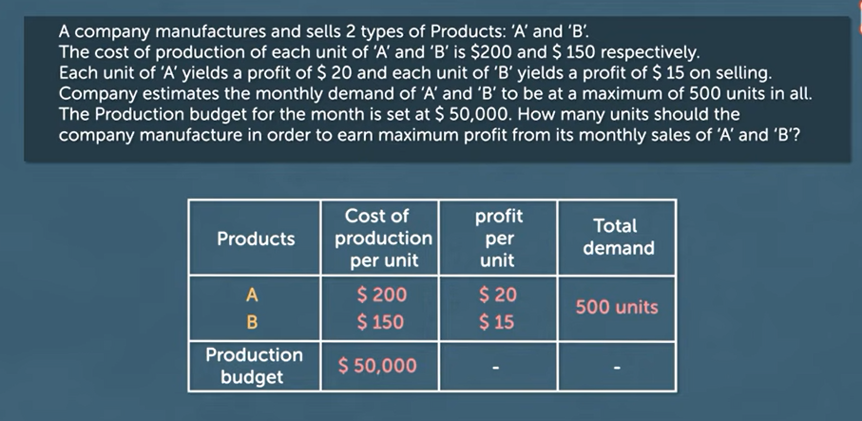
Formulation of LPP

Slide 8
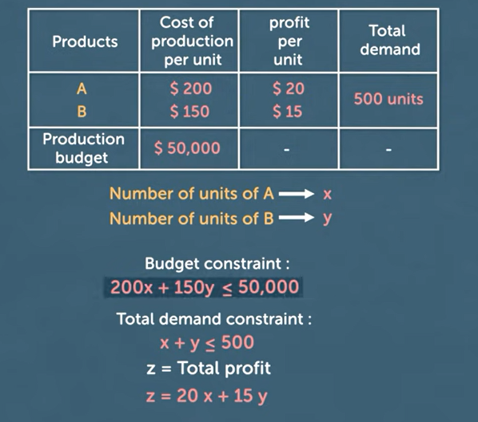
Formulation of LPP

Slide 9
Case study
A small cooperative craft workshop makes two types of table: a standard rectangular table and a de luxe circular table. The market can absorb as many of either type of table as the workshop can produce, and so we can assume unlimited demand. Each type of table is made from the same wood and, once the wood has been cut, each table has to go through three processes: joinery, pre ﬁnishing and ﬁnal ﬁnishing (in that order). Suﬃcient cut wood is always available.
Each rectangular table takes 2 hours for joinery, 40 minutes for pre ﬁnishing and 5 hours 20 minutes for ﬁnal ﬁnishing. Each circular table requires 3 hours for joinery, 2 hours for pre-ﬁnishing and 4 hours for ﬁnal ﬁnishing. The workshop employs ﬁve joiners, two sanders and eight polishers. The joiners each work a ﬁxed six-hour day, while the sanders and polishers each work a ﬁxed eight-hour day on the pre ﬁnishing and ﬁnal ﬁnishing respectively. No overtime is worked, and full six-hour or eight-hour days are worked by each employee irrespective of whether there is work for that employee to do. All running costs, including wages, are ﬁxed. The cooperative sells each rectangular table for £120 and each circular table for £150. How many of each type of table should it produce each day in order to maximize its proﬁt?

Slide 10
Formulating Objective function
The quantity to be optimized in a mathematical programming problem is known as the objective function, and the objective is to optimize this function.
The ﬁrst step in formulating a linear programming model is to identify the objective and it’s objective function.
In this example, we want to maximize the daily proﬁt, so we could take maximizing the daily product as the objective and the daily proﬁt as the objective function.
However, the daily proﬁt is equal to the daily income from selling tables less the ﬁxed daily running costs (including the cost of wood and wages). So, since the running costs are ﬁxed, maximizing daily proﬁt is equivalent to maximizing daily income.

Slide 11
Some commonly used terms in linear programming problems are
Objective function: The direct function of form Z = ax + by, where a and b are constant, which is reduced or enlarged is called the objective function. For example, if Z = 13x + 21y. The variables x and y are called the decision variable.
Constraints: The restrictions that are applied to a linear inequality are called constraints.
Non-negative constraints: x > 0, y > 0 etc.
General constraints: x + y > 30, 3x + 4y ≥ 20 etc.
Optimization problem: A problem that seeks to maximization or minimization of variables of linear inequality problem is called optimization problems.
Optimal (most feasible) solution: Any point in the emerging region that provides the right amount (maximum or minimum) of the objective function is called the optimal solution.

Slide 12
Objective function (Cont..)
As omitting the ﬁxed running costs will simplify the model, we shall therefore take the objective to be to maximize daily product and the objective function to the daily income.
The second step is to identify the variables, other than the objective function, and to specify their units of measurement.
In this example, the only variables are the numbers of tables of each type made per day.
The third step is to identify the constraints and parameters. In this example the only constraints are the numbers of person-hours available for joinery, pre ﬁnishing and ﬁnal ﬁnishing each day. The parameters are the time it takes for each process for each type of table, the hours available for each process each day, and the selling prices of the tables

Slide 13
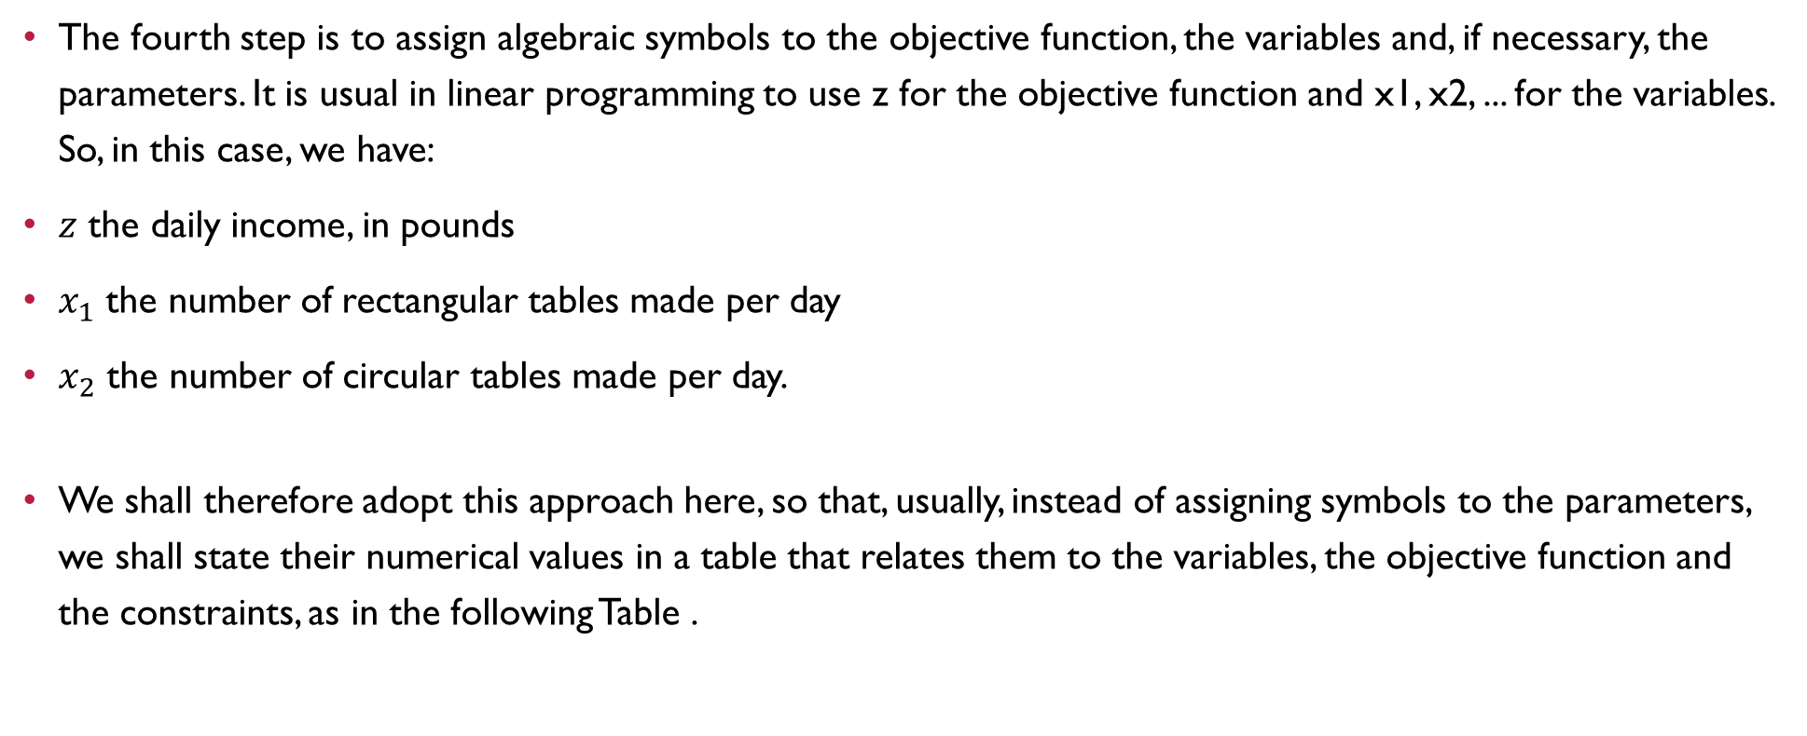
Decision Variables
The fourth step is to assign algebraic symbols to the objective function, the variables and, if necessary, the parameters. It is usual in linear programming to use z for the objective function and x1, x2, ... for the variables. So, in this case, we have:
$z$ the daily income, in pounds
$x_{1}$ the number of rectangular tables made per day
$x_{2}$ the number of circular tables made per day.
We shall therefore adopt this approach here, so that, usually, instead of assigning symbols to the parameters, we shall state their numerical values in a table that relates them to the variables, the objective function and the constraints, as in the following Table .

Slide 14
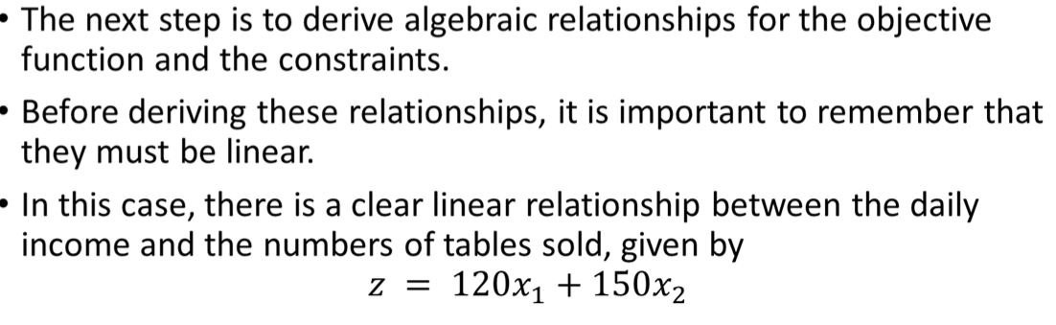
Tabulating data for formulation
 | Rectangle Table | Circular Table | upper limit(Per Day)
income (£) | 120 | 150 | -
joinery (hours) | 2 | 3 | 30
Pre ﬁnishing (hours) | 2/3 | 2 | 16
ﬁnal ﬁnishing (hours) | 5 1/3 | 4 | 64
Rectangle Table

Slide 15
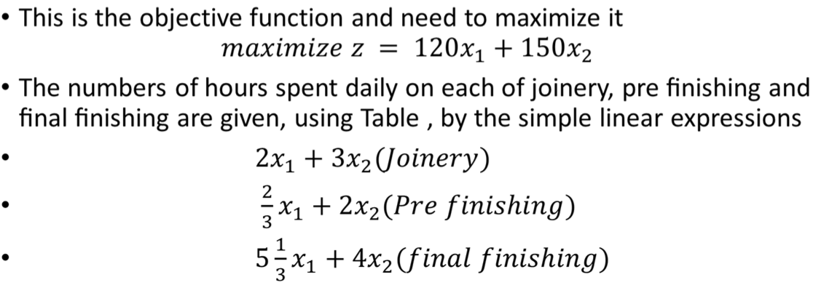
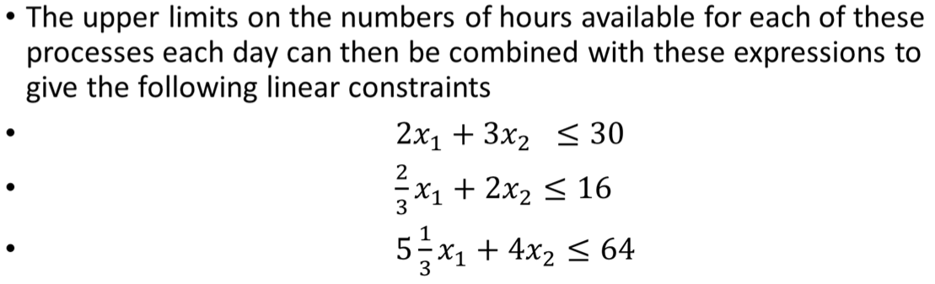
Formulation of Constraints

Slide 16
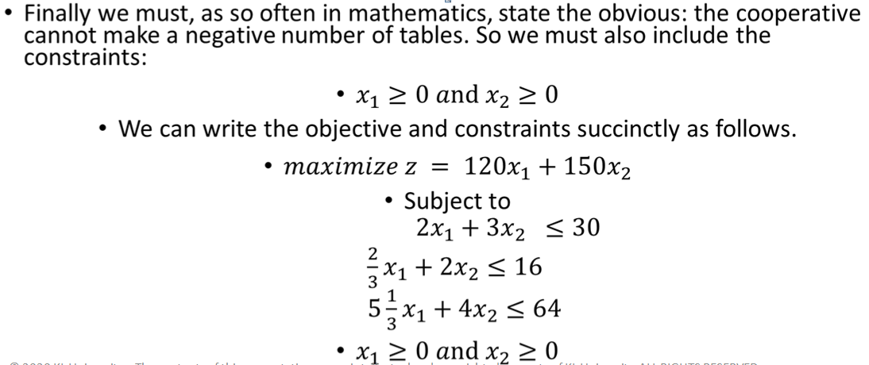
Final Formulation by adding non-negative constraints

Slide 17
questions
What is the significance of objective function in a linear programming problem
Give examples of a minimization problem and maximization problem
What are decision variables
What are constraints
What are non-negative constrains

Slide 18
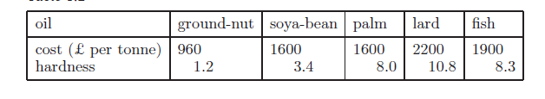
Class work: LPP formulation problem
A food manufacturer buys edible oils in their raw state, and refines and blends them to produce margarine. The raw oils can be vegetable or non-vegetable. The vegetable oils are ground-nut, soya-bean and palm. The non-vegetable oils are lard and fish. The margarine sells at £2400 a tonne, and the manufacturer can sell as much margarine as can be made. The prices of the raw oils are shown in Table . Sufficient quantities of all five oils can be assumed to be readily available.

Slide 19
Problem Continued…
To avoid contamination, vegetable and non-vegetable oils are refined separately, using different equipment. It is possible to refine up to 1000 tones of vegetable oil and up to 800 tones of non-vegetable oil in a month. When refined, some or all of the oils are blended to produce the margarine.
The quantities of oil lost during the refining and blending processes are negligible.
The hardnesses of the refined oils, given in Table , are assumed to combine linearly to give the hardness of the margarine. To ensure that the margarine spreads easily but is not runny, the hardness of the margarine must be between 5.6 and 7.4, measured in the same units as the hardnesses of the oils in Table . All running costs can be taken to be fixed. The manufacturer wants to know how much of each type of oil to use in order to maximize profit while maintaining the quality of the margarine.

Slide 20
Formulation
We follow the steps of Procedure
(a) The purpose of the model is to maximize profit, subject to constraints on resources, while maintaining quality. Since the refining capacities are given per month, it is sensible to work on a monthly basis. We could therefore take maximizing monthly profit as the objective. However, since the running costs are fixed, maximizing monthly profit is equivalent to maximizing monthly income. Therefore, as omitting the fixed running cost will simplify the model, we shall take the objective as maximizing monthly income. This monthly income could be measured in pounds. However, looking at the quantities involved, it would seem more sensible to work in units of £10 000.
© 2020 KL University – The contents of this presentation are an intellectual and copyrighted property of KL University. ALL RIGHTS RESERVED

Slide 21
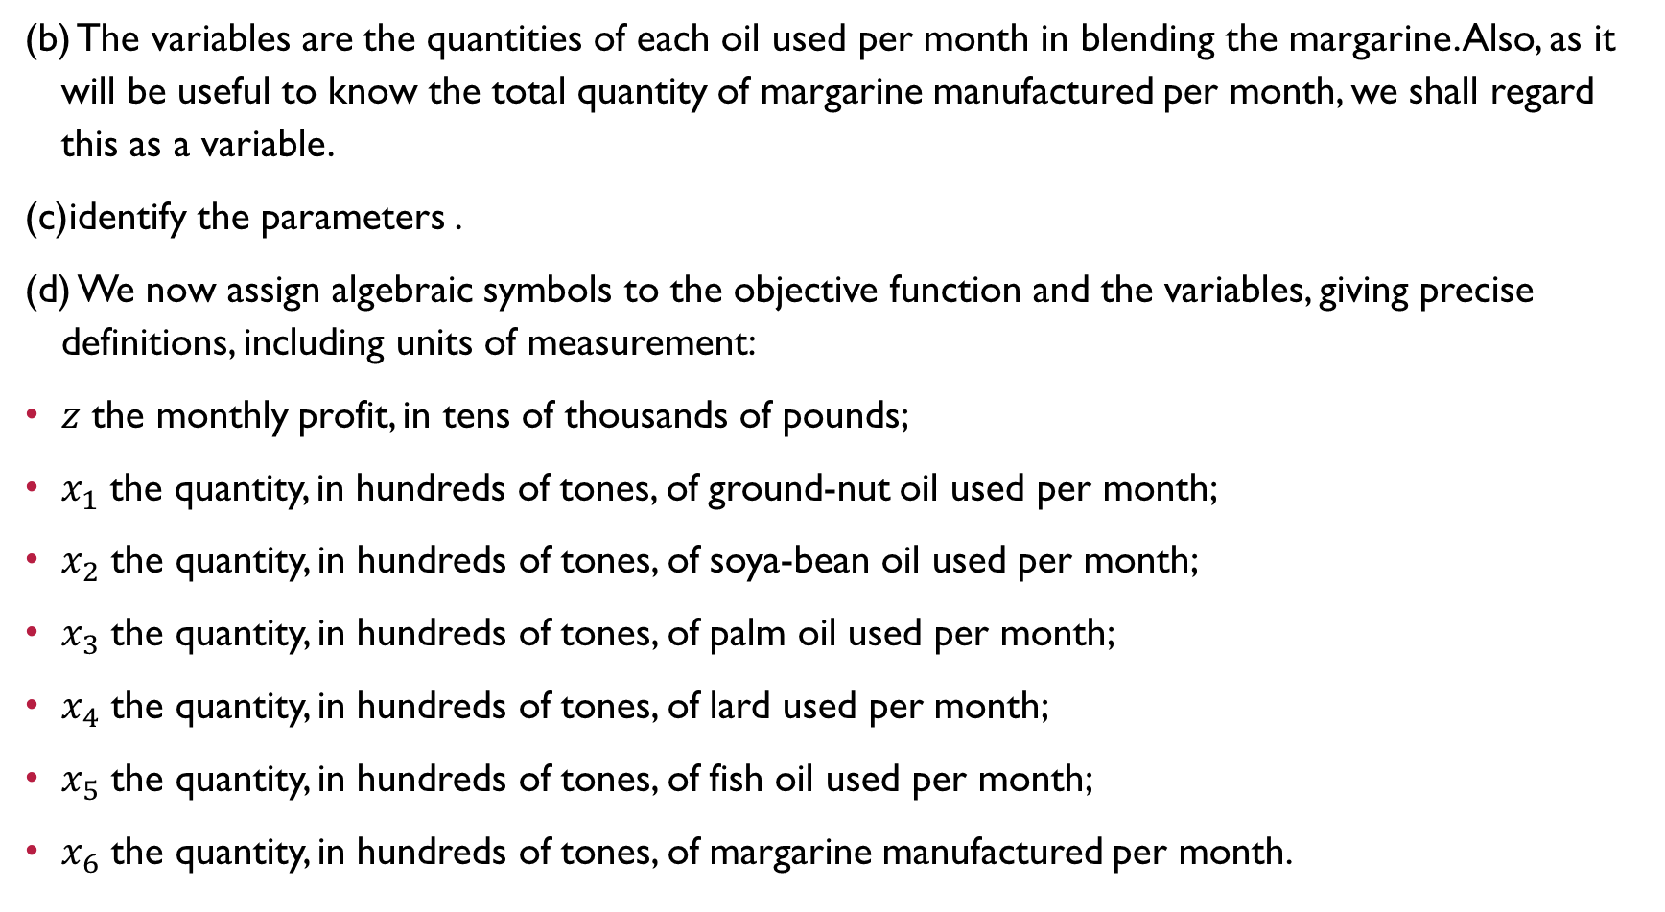
(b) The variables are the quantities of each oil used per month in blending the margarine. Also, as it will be useful to know the total quantity of margarine manufactured per month, we shall regard this as a variable.
(c)identify the parameters .
(d) We now assign algebraic symbols to the objective function and the variables, giving precise definitions, including units of measurement:
$z$ the monthly profit, in tens of thousands of pounds;
$x_{1}$ the quantity, in hundreds of tones, of ground-nut oil used per month;
$x_{2}$ the quantity, in hundreds of tones, of soya-bean oil used per month;
$x_{3}$ the quantity, in hundreds of tones, of palm oil used per month;
$x_{4}$ the quantity, in hundreds of tones, of lard used per month;
$x_{5}$ the quantity, in hundreds of tones, of fish oil used per month;
$x_{6}$ the quantity, in hundreds of tones, of margarine manufactured per month.

Slide 22
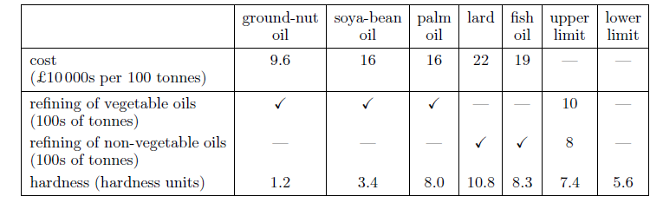
(e) We next identify the linear relationships for the objective function
and the constraints. We can do this by extending Table , and making
suitable adjustments to the numerical values to take into account the
units of measurement decided on in (a) and (b), and listed in (d). This
results in the following Table :
© 2020 KL University – The contents of this presentation are an intellectual and copyrighted property of KL University. ALL RIGHTS RESERVED

Slide 23
(f) Determine the objective function and objective of the problem in terms of x1, . . . , x6
(g) We now want to express the constraints algebraically in terms of the variables.
The hardness constraints require some thought.
Remember that the hardnesses of the components combine linearly to give the hardness of the margarine, which must be at least 5.6.
Using Table this means that we must have
© 2020 KL University – The contents of this presentation are an intellectual and copyrighted property of KL University. ALL RIGHTS RESERVED

Slide 24



If, for consistency, we keep all variables to the left-hand side of inequality or equality signs, this becomes
We must also remember the quantity constraint, which can be written as
or, in the format of the other constraints, as
© 2020 KL University – The contents of this presentation are an intellectual and copyrighted property of KL University. ALL RIGHTS RESERVED

Slide 25
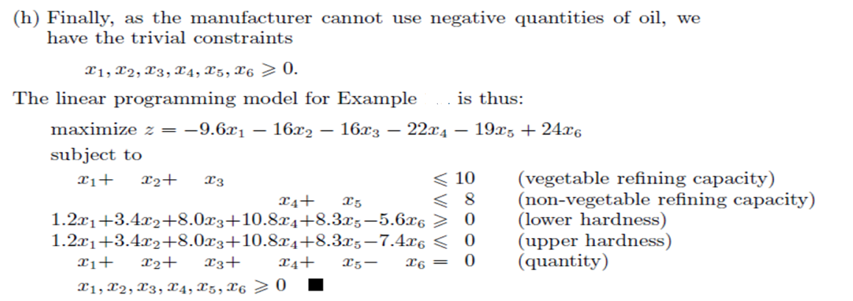
© 2020 KL University – The contents of this presentation are an intellectual and copyrighted property of KL University. ALL RIGHTS RESERVED

Slide 26
Food Type | Yeild per unit |  |  | Cost per Unit
 | Protiens | Fats | Carbohydrates
1 | 3 | 2 | 6 | 45
2 | 4 | 2 | 4 | 40
3 | 8 | 7 | 7 | 85
4 | 6 | 5 | 4 | 65
Minimum requirement | 800 | 200 | 700

Slide 27
Formulate linear programming problem for the given problem.
Solution:
Let x₁,x₂,x₃ and x₄ denote the number of units of food type 1,2,3 and 4 respectively. The objective is to minimize the cost.
Minimize Z=45x₁+40x₂+85x₃+65x₄
subject to the constraints
3x₁+4x₂+8x₃+6x₄>=800
2x₁+2x₂+7x₃+5x₄>=200
6x₁+4x₂+7x₃+4x₄>=700
where x₁,x₂,x₃ and x₄>=0.
This is called an Linear Programming Problem( LPP).

Slide 28
Machines | Time per unit ( minutes ) |  |  | Machine capacity
 | Product-1 | Product-2 | Product-3
M1 | 2 | 3 | 2 | 440
M2 | 4 | -- | 3 | 470
M3 | 2 | 5 | -- | 430

Slide 29
Solution:
Let the amounts of products 1,2 and 3 manufactured daily be x1,x2 and x3 units respectively. Clearly x1,x2 and x3 are clearly >=0
In this problem, The objective function is
Maximize Z=4x₁+3x₂+6x₃
Since, the constraints are on machine capacities and can be mathematically expressed as
2x₁+3x₂+2x₃<=440
4x₁+0x₂+3x₃<=470
2x₁+5x₂+0x₃<=430
where x₁,x₂,x₃ are >=0.

Slide 30
Hence, The given problem can be formulated as an LP problem by
Maximize Z = 4x₁+3x₂+6x₃
Subject to the constraints
2x₁+3x₂+2x₃<=440
4x₁+0x₂+3x₃<=470
2x₁+5x₂+0x₃<=430
where x₁,x₂,x₃ are >=0

Slide 31
References
Textbook:
1. Introduction to Mathematical Programming by Russell C. Walker, published by Pearson Custom Publishing, 2006
2. S. P. Bradley, A. C. Hax, and T. L. Magnanti, Applied Mathematical Programming, Addison-Wesley Publishing Company, 1977
3. Lenstra, Rinnooy Kan, & Schrijver (eds.), History of Mathematical Programming: A Collection of Personal Reminiscences, Elsevier, 1991.
Web Resources
https://nptel.ac.in/courses/110105096
https://www.coursera.org/learn/operations-research-modeling
https://www.semanticscholar.org/paper/Applied-Mathematical-Programming-Bradley-Hax/8a4ee083b23505df221410e6a2b41fc56fa250a6

Slide 32

THANK YOU
Team – Mathematical Optimization

